Slide 1
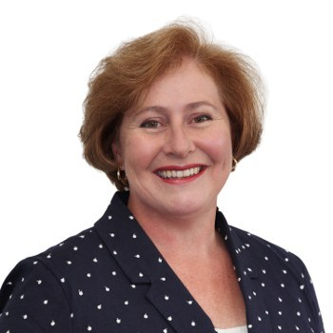
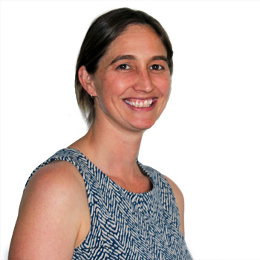
APRIL 2023
Myob exo
EMPLOYER SERVICES
DIANNE SEMMENS
TONYA SEY
Managing Director
MYOB Exo & Advanced
Senior Consultant
MYOB Exo & Advanced
Notes:
Di to do introduction

Slide 2
EMPLOYER SERVICES
BREAKING NEWS: NEW RELEASE 2022.05 MUST BE INSTALLED BY 29TH APRIL 2023
Version 2022.04 – password updates
Family domestic violence leave
EMPLOYEE & PAY LISTS
Deleting open pays!
EMAILING AND PAYSLIPS

Slide 3
BREAKING NEWS: RELEASE 2022.05
MUST BE INSTALLED BY 29TH APRIL 2023
Available now for download
Disclaimer: The information presented is generic in nature and may not refer to an individual’s specific requirements.
If you have specific queries, please contact Acacia Consulting Services to speak with a certified Exo consultant.
Notes:
Communication changes with the ATO included in release 2022.5. This will be needed for all STP lodgements to the ATO by 29th April 2023.

Slide 4
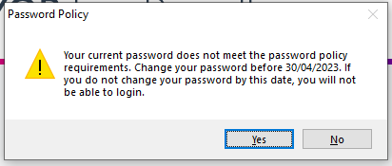
Version 2022.04 – password updates
(ensure running 2022.04 not 2022.03)
Disclaimer: The information presented is generic in nature and may not refer to an individual’s specific requirements.
If you have specific queries, please contact Acacia Consulting Services to speak with a certified Exo consultant.
Notes:
Ensure running 2022.04 not 2022.03 – STP lodgement issue
To comply with ATO requirements
Login and see message re changing password
Note:
Key date = 30th April 2023

Slide 5
Family domestic violence leave (FDVL)
Australian Government introduced paid family and domestic violence leave (FDVL) for all employees (i.e. full time, part time and casual).
Effective dates:
15+ employees: 1 February 2023
<15 employees: 1 August 2023
https://www.fairwork.gov.au/leave/family-and-domestic-violence-leave/paid-family-and-domestic-violence-leave
We recommend that if you are required to pay FDVL, seek clarity from a registered authority (eg Fair Work Australia, employment lawyer, tax agent or ATO) on the rate to pay your employee.
Disclaimer: The information presented is generic in nature and may not refer to an individual’s specific requirements.
If you have specific queries, please contact Acacia Consulting Services to speak with a certified Exo consultant.
Notes:
Open Setup Exo Payroll – Leave Management.
Open employee # 2 – click on Leave Entitlements
Open Current pay for employee # 2 show processing FDVL

Slide 6
EMPLOYEE LIST
PAY LIST
Disclaimer: The information presented is generic in nature and may not refer to an individual’s specific requirements.
If you have specific queries, please contact Acacia Consulting Services to speak with a certified Exo consultant.
Notes:
Open List view screens and discuss.
ATO status
Employee information
Export option
Employee List Show adding columns and saving the view
Show Leave Balance View off menu

Slide 7
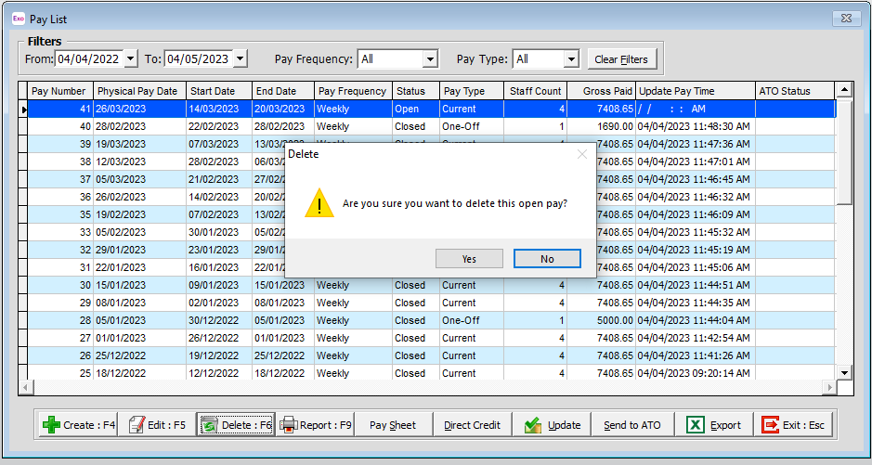
Deleting open pays!!!
Disclaimer: The information presented is generic in nature and may not refer to an individual’s specific requirements.
If you have specific queries, please contact Acacia Consulting Services to speak with a certified Exo consultant.
Notes:
Open Pay List screen
Select to delete an open pay

Slide 8
EMAILING AND PAYSLIPS
Microsoft is planning to phase out basic authentication of emails sent via SMTP.
MYOB have included the option to send pay slips via the MYOB email server.
Note: you can continue to send pay slips via your email server if it meets the Microsoft authentication requirements.
Example Email from MYOB Email Server
Disclaimer: The information presented is generic in nature and may not refer to an individual’s specific requirements.
If you have specific queries, please contact Acacia Consulting Services to speak with a certified Exo consultant.
Notes:
Open Utilities screen and discuss email server settings.

Slide 9
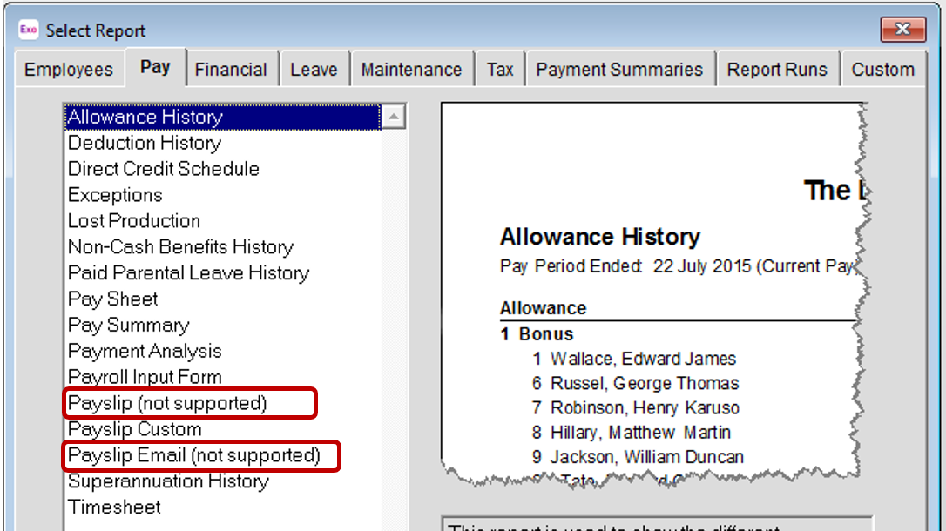
EMAILING AND PAYSLIPS
Older styled payslips no longer supported
Disclaimer: The information presented is generic in nature and may not refer to an individual’s specific requirements.
If you have specific queries, please contact Acacia Consulting Services to speak with a certified Exo consultant.

Slide 10
Q&a
OVER TO YOU
Notes:
Di to do introduction

Slide 11
THANK YOU FOR JOINING US
Next EXO water cooler: AUGUST
END OF FINANCIAL YEAR WEBINARS IN JUNE
SEND THROUGH YOUR TOPIC IDEAS
PLEASE SEND IDEAS TO HELPDESK@ACACIACS.COM.AU
Notes:
Di to do introduction

